Slide 1
Evolution of Resolution
Under
Optical microscope

Slide 2
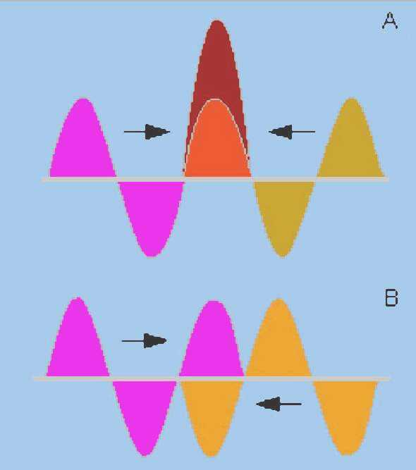
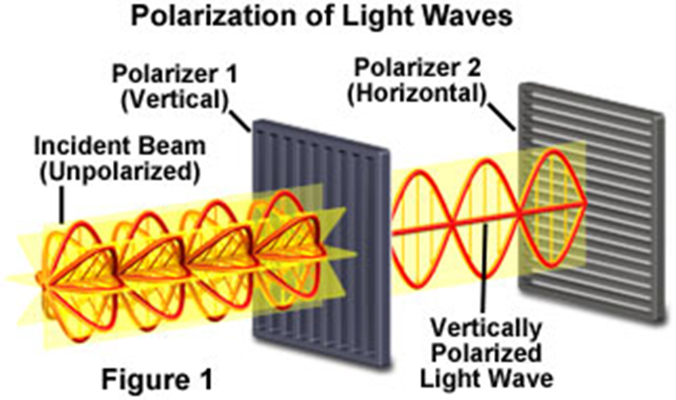
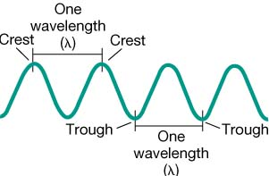
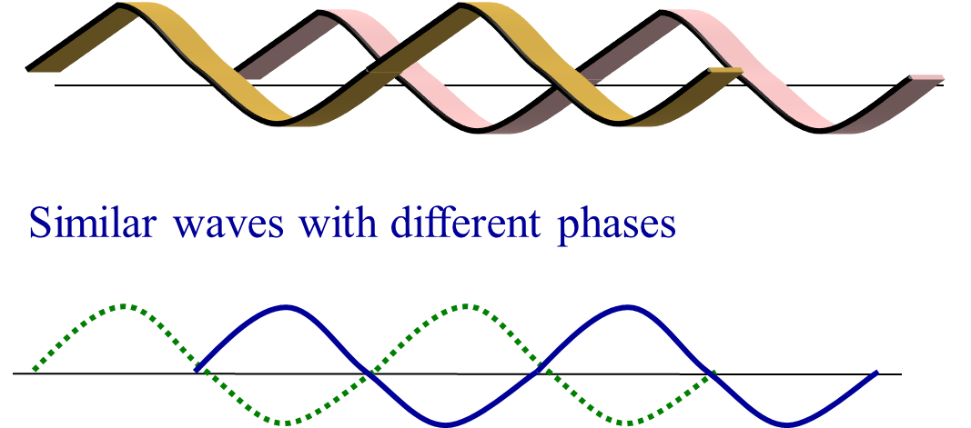
Light
Properties of light

Slide 3
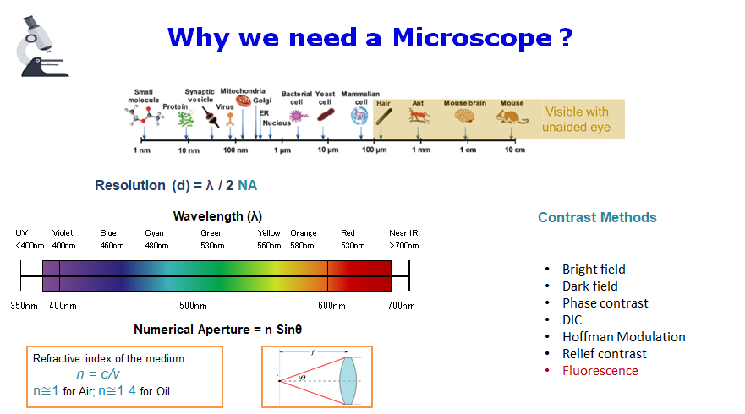
Resolution

Slide 4
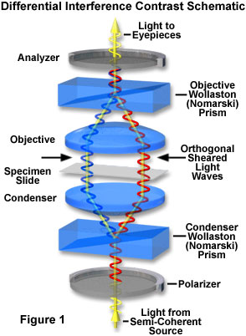
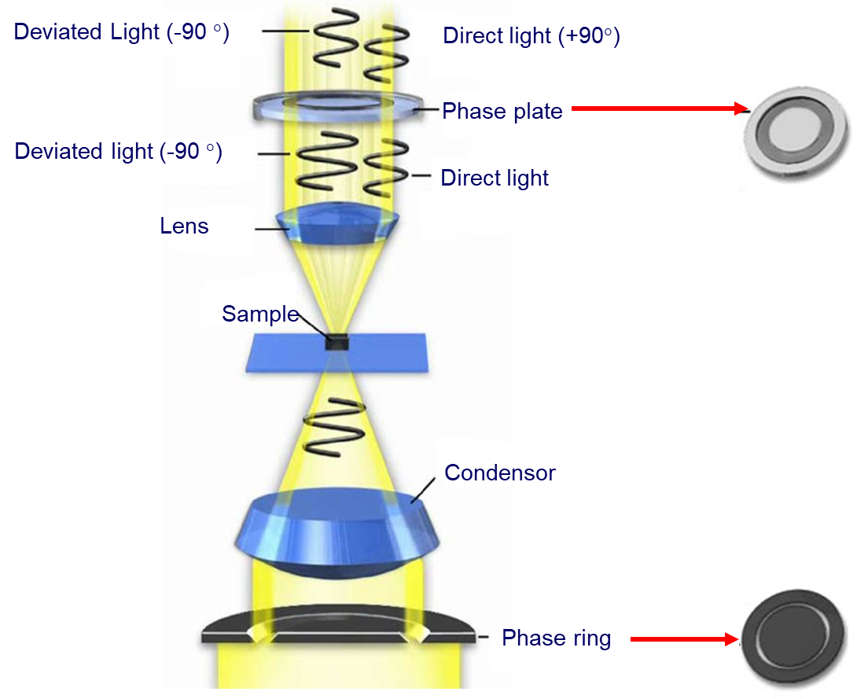
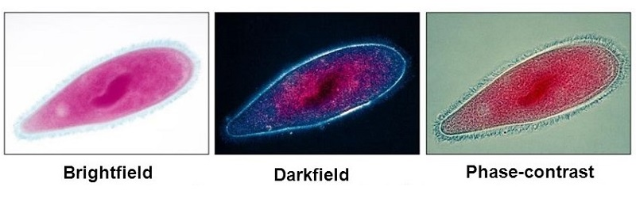
Contrast & Color
DIC vs Phase Contrast
Phase Contrast Schematic
Glass, ~ 200 µm
Glass/Plastic, ~ 5-10 µm

Slide 5
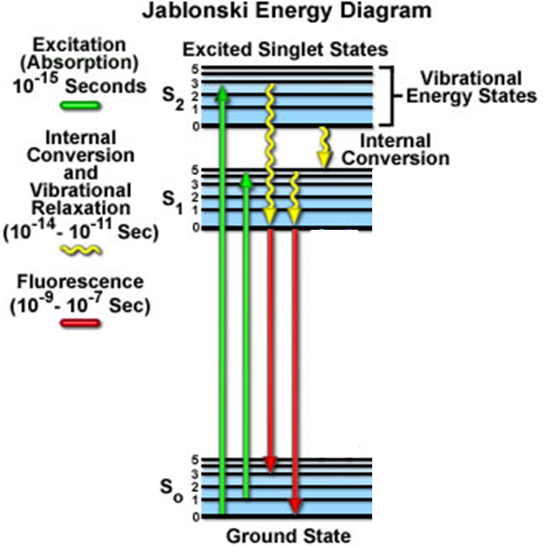
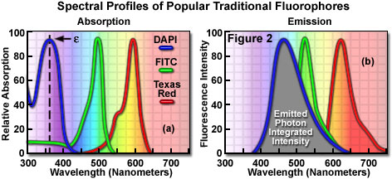
Fluorescence

Slide 6
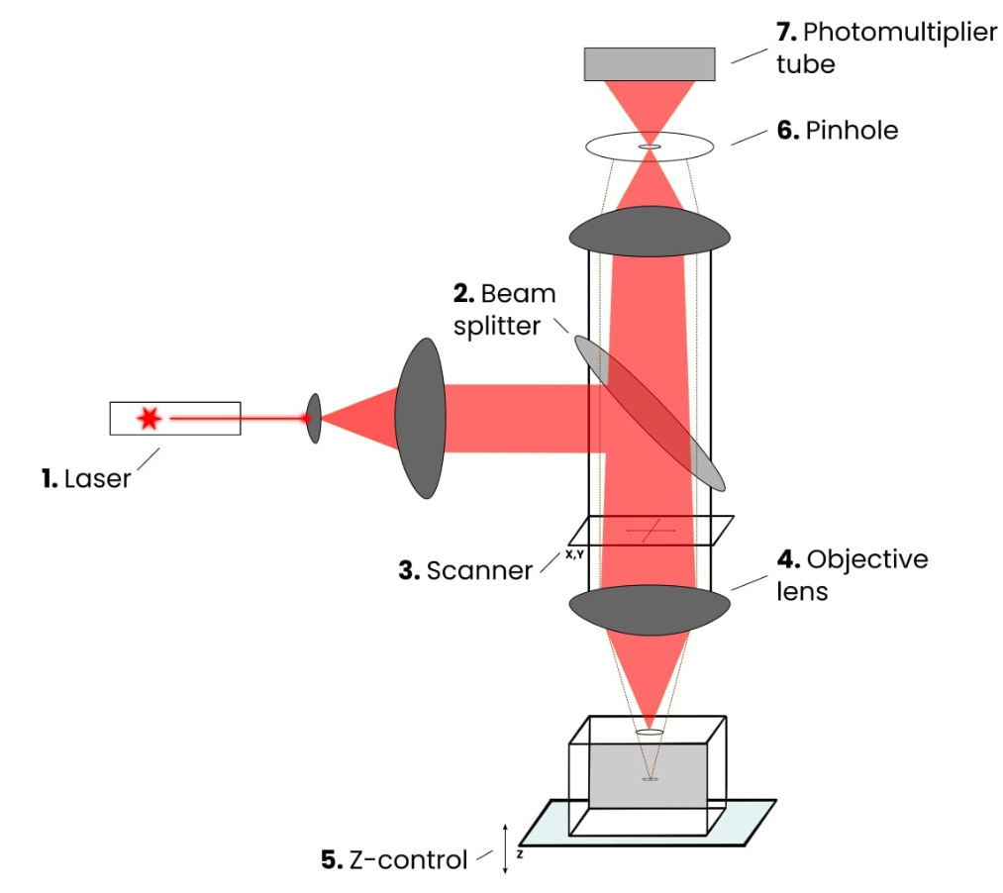
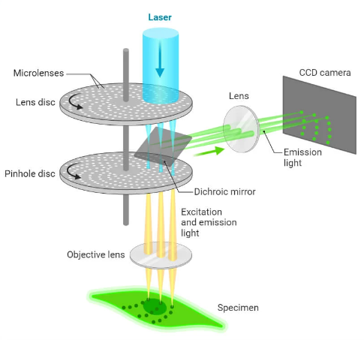
LASER SCANNING CONFOCAL
SPINNING DISK CONFOCAL
Confocal

Slide 7
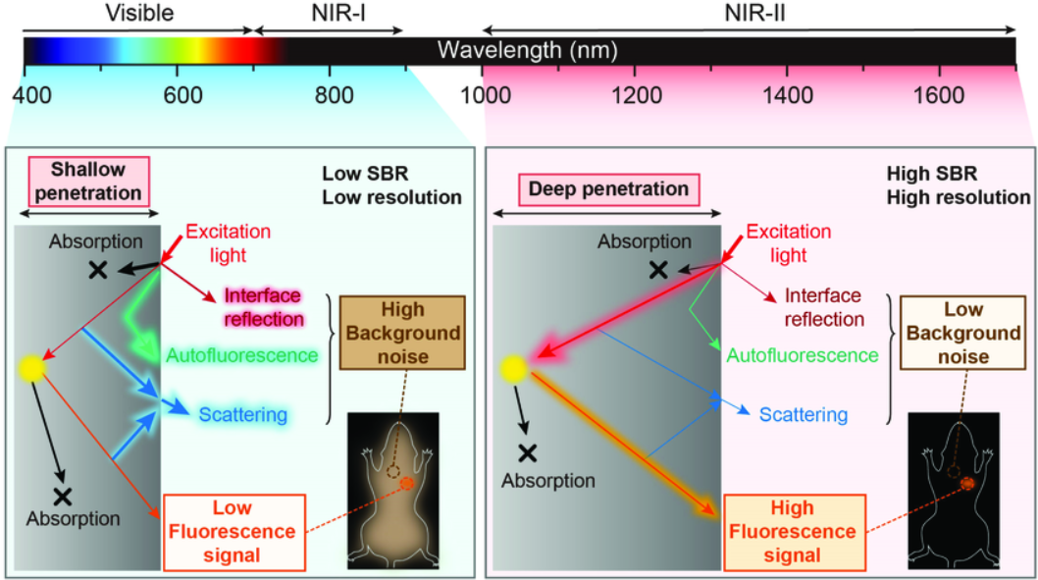
NIR & Two Photon

Slide 8
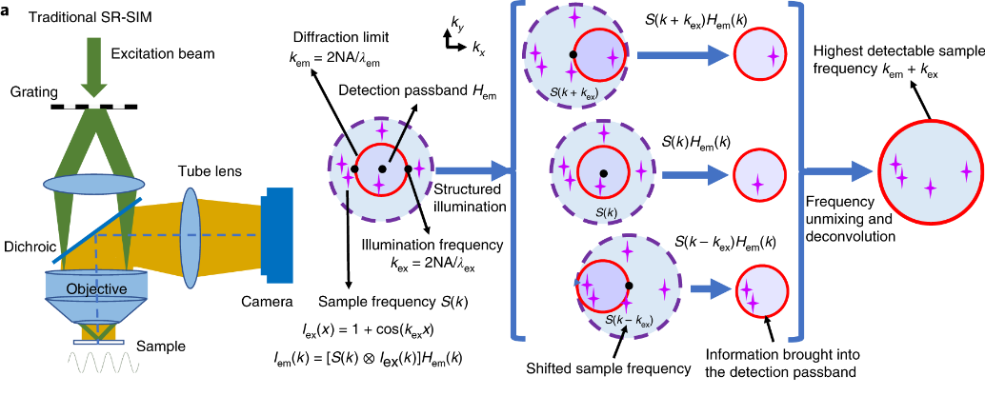
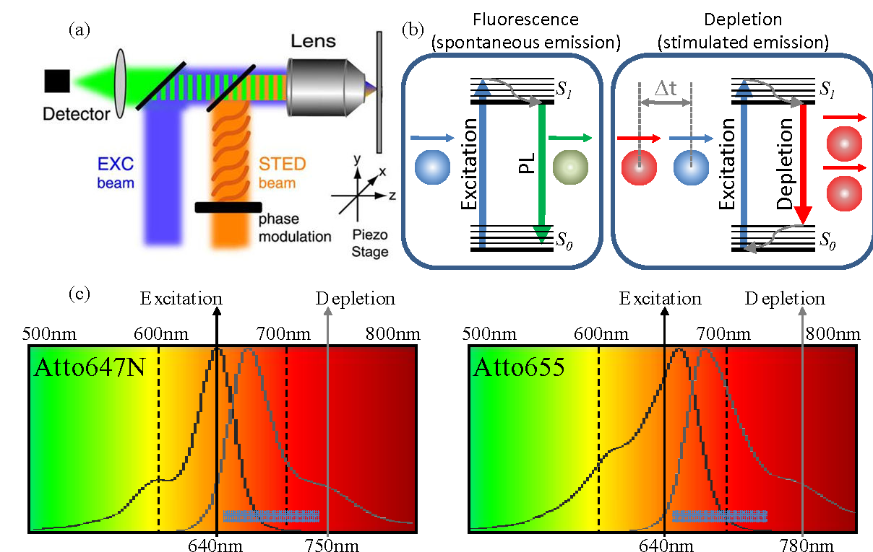
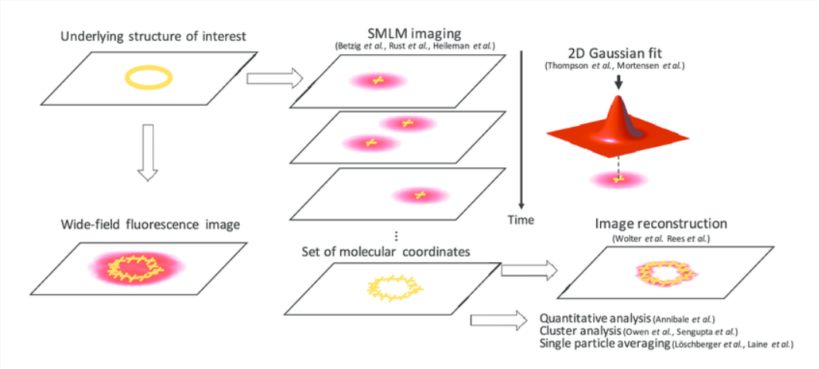
Super Resolution
SIM ~ 70-90nm
Wu, Y., Shroff, H. Faster, sharper, and deeper: structured illumination microscopy for biological imaging. Nat Methods 15, 1011–1019 (2018). https://doi.org/10.1038/s41592-018-0211-z
STED ~ 30nm
https://www.semanticscholar.org/paper/Stimulated-Emission-Depletion-(STED)-Microscopy%3A-to-Farahani-Schibler/4bf45c891c77216fc88e21bdd41979908abbcf70
SMLM < 20nm
Localization Precision
STORM, PALM…
https://www.researchgate.net/figure/Principle-of-SMLM-If-the-underlying-structure-here-a-yellow-circle-is-labelled_fig1_303385472

Slide 9
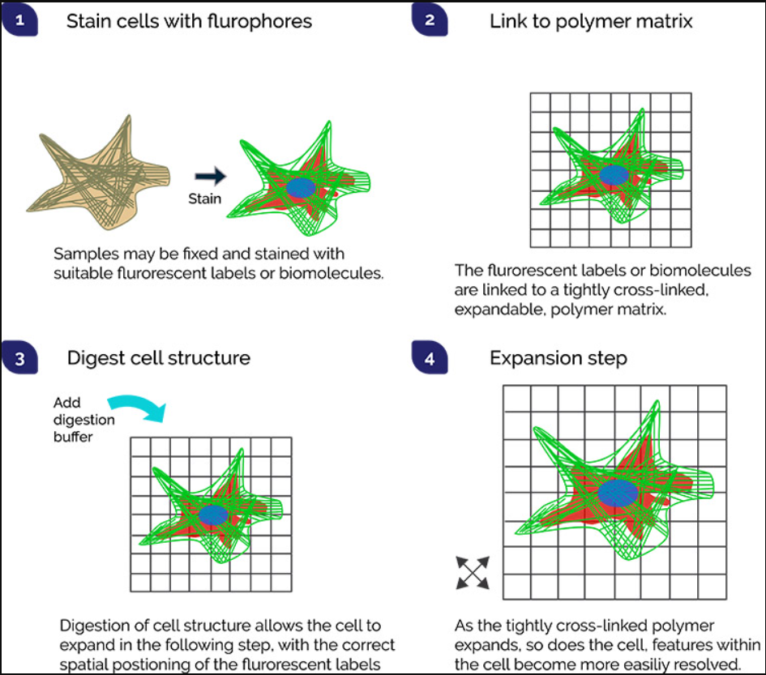
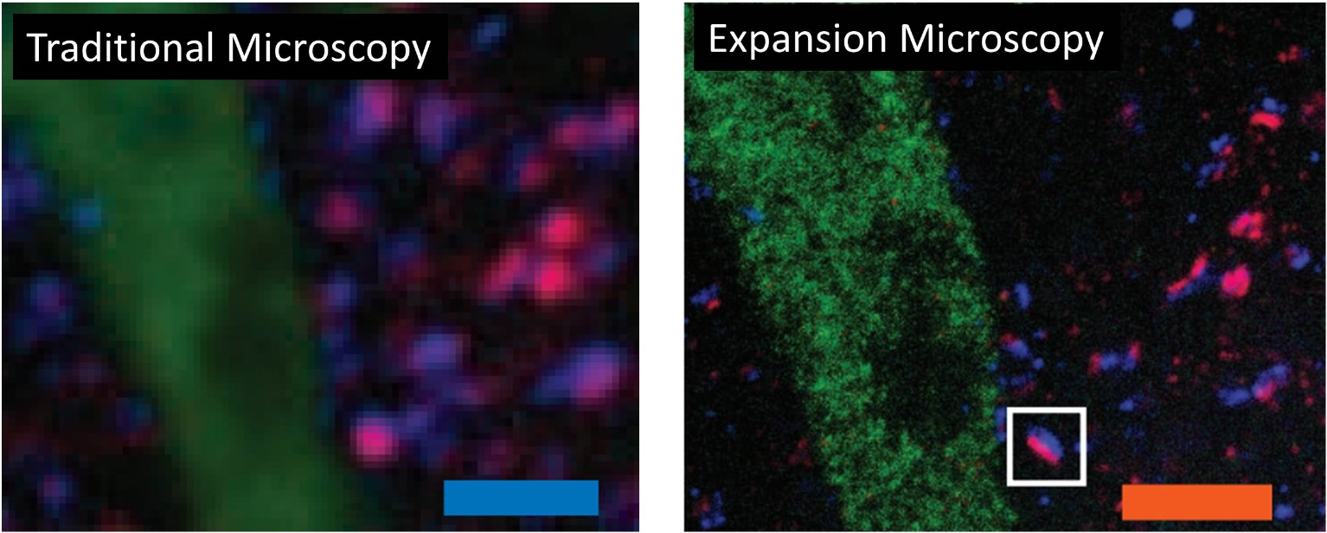
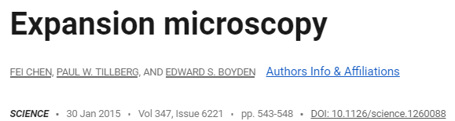
Expansion Microscopy
https://www.science.org/doi/10.1126/science.1260088
Strack, R. Expansion microscopy. Nat Methods 14, 32 (2017). https://doi.org/10.1038/nmeth.4113

Slide 10
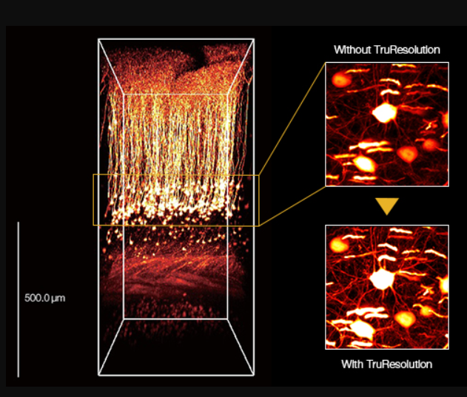
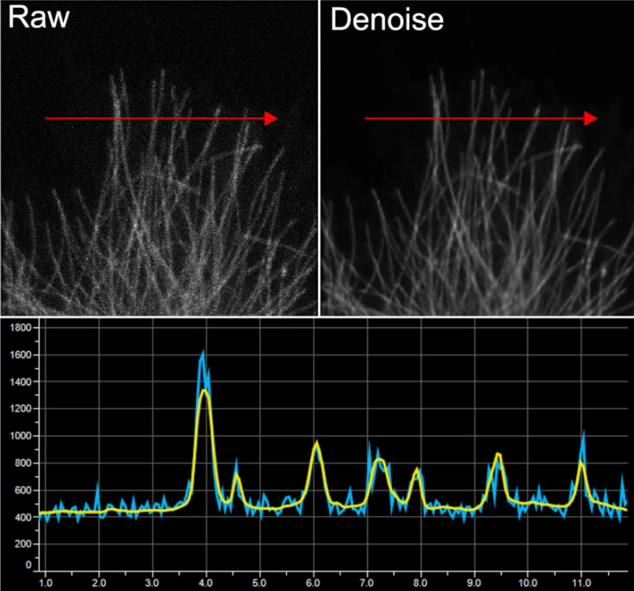
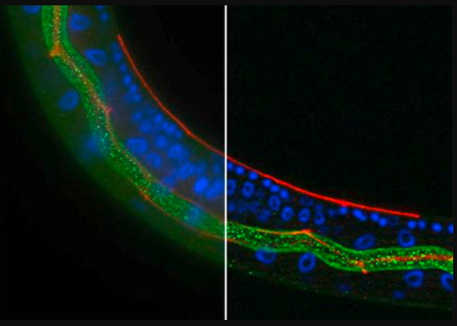
Image Processing
3D Reconstruction
Deconvolution
Deblur
2D Deconvolution
3D Deconvolution

Slide 11
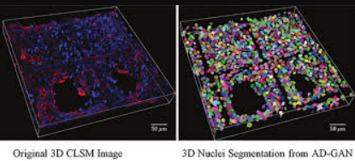
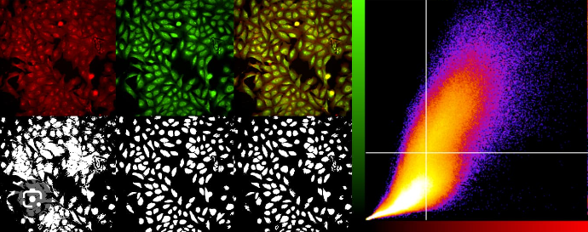
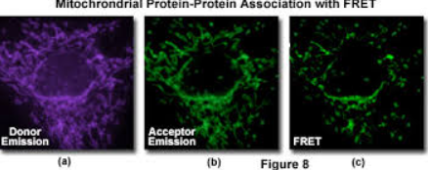

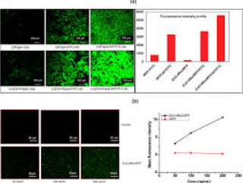
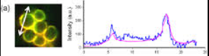
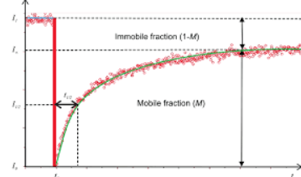
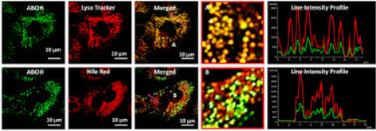
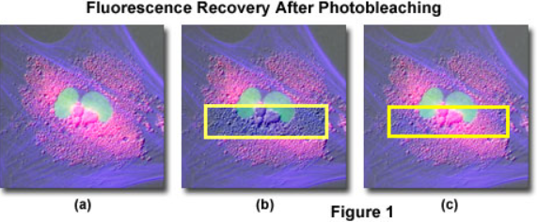
Data Analysis
FRET – Molecular Interaction
Intensity Profiling
Line Profiling
FRAP

Slide 12
AI and Imaging
AI based Denoising
AI based Image segmentation & Measurement
AI based – Label imaging
AI based 3D image analysis

Slide 13
Conclusion

